Slide 1
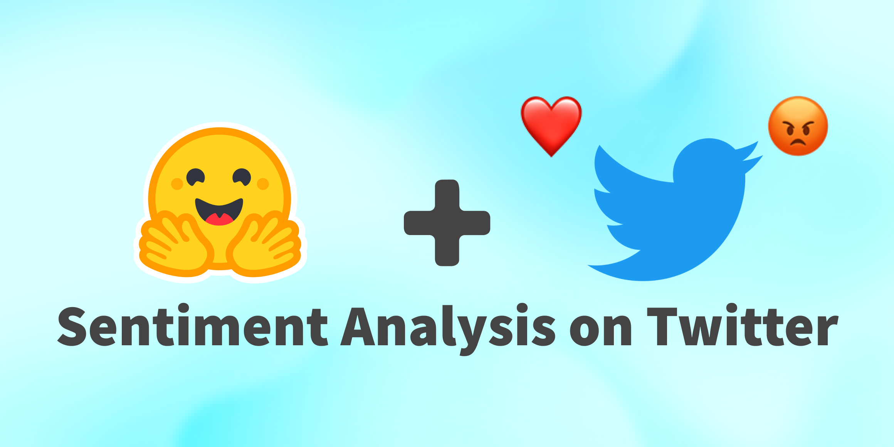
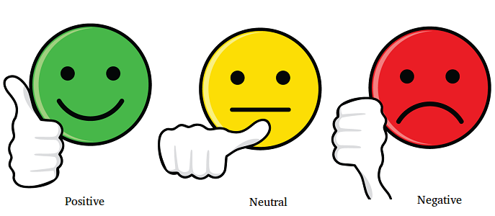
Bandi Supriya

Slide 2

Problem statement
The task at hand is to develop a classification model that can accurately predict the sentiment of COVID-19-related tweets. These tweets have been collected from Twitter and manually labeled with sentiment categories. To protect privacy, names and usernames have been anonymized using codes.
Given the information of the tweet's location, timestamp, and the original tweet text, the model needs to classify each tweet into one of several sentiment labels. The objective is to create a reliable model that can effectively identify and categorize the sentiment expressed in COVID-19 tweets, enabling better understanding of public sentiment during the pandemic.

Slide 3

What is Twitter Sentiment Analysis
A Twitter sentiment analysis is the process of determining the emotional tone behind a series of words, specifically on Twitter.
A sentiment analysis tool is an automated technique that extracts meaningful customer information related to their attitudes, emotions, and opinions.

Slide 4
Columns Information of Dataset
User Name: The anonymized code or identifier assigned to each user who posted the tweet.
Screen Name: The anonymized code or identifier for the user's screen name or username on Twitter.
Location: The location information of the user, indicating where they are located or where they claim to be located. This could be a city, country, or any other geographical information.
Tweet At: The timestamp or date/time when the tweet was posted by the user.
Original Tweet: The actual text content of the tweet posted by the user.
Label: The sentiment label assigned to the tweet, indicating the sentiment expressed in the tweet. This could include categories such as positive, negative, neutral, or any other sentiment labels used in the dataset.

Slide 5
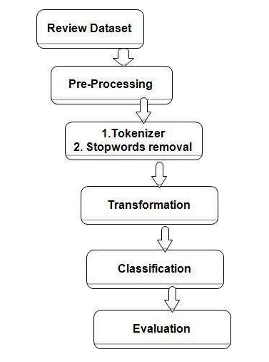
Steps Involved in this Project

Slide 6
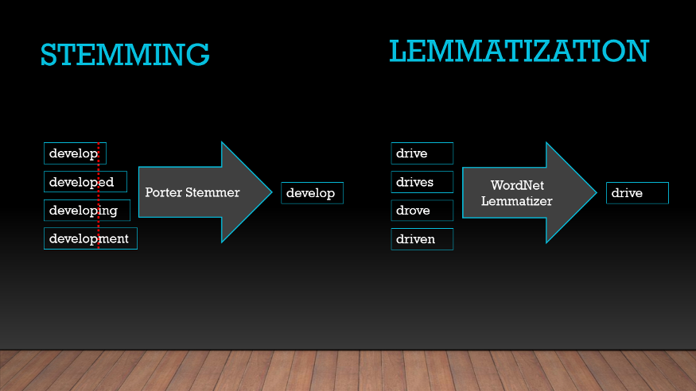
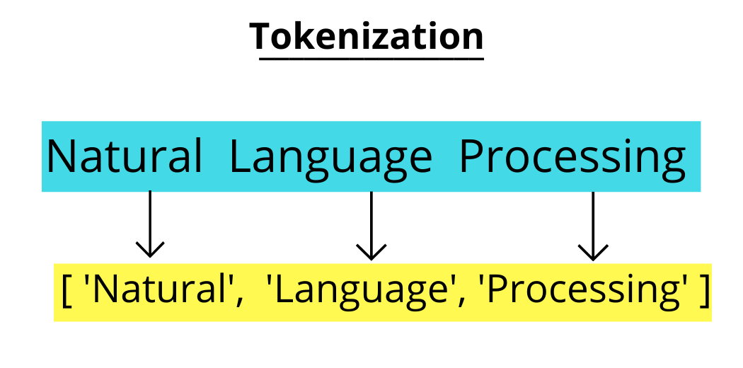
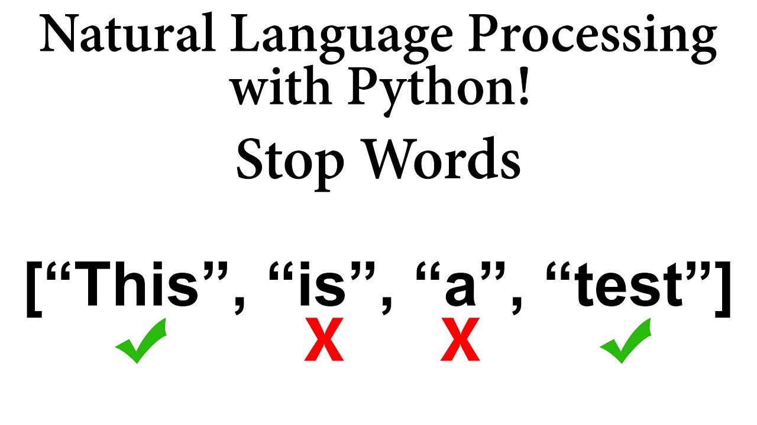

Slide 7
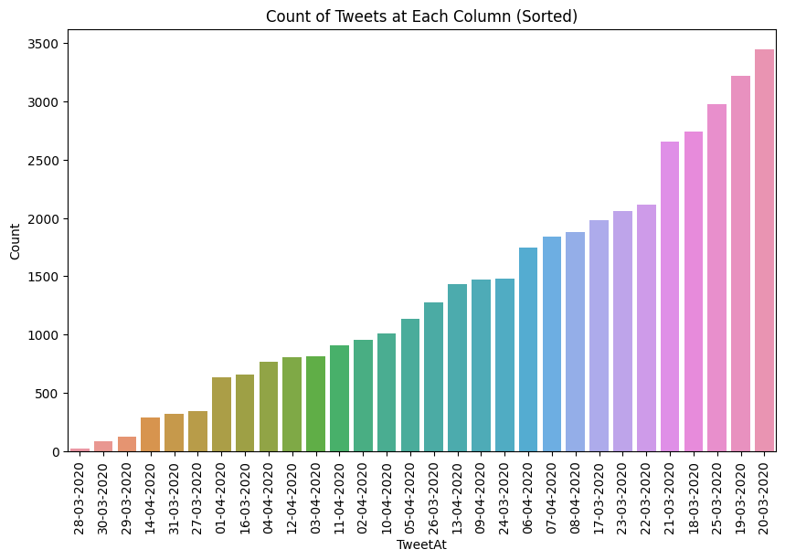
Day wise Tweet Count
The count plot indicates a significant spike in tweet activity on 20-03-2020, suggesting that it was a date of particular significance or interest for Twitter users. On the other hand, 28-03-2020 stands out as a date with notably lower tweet engagement.

Slide 8
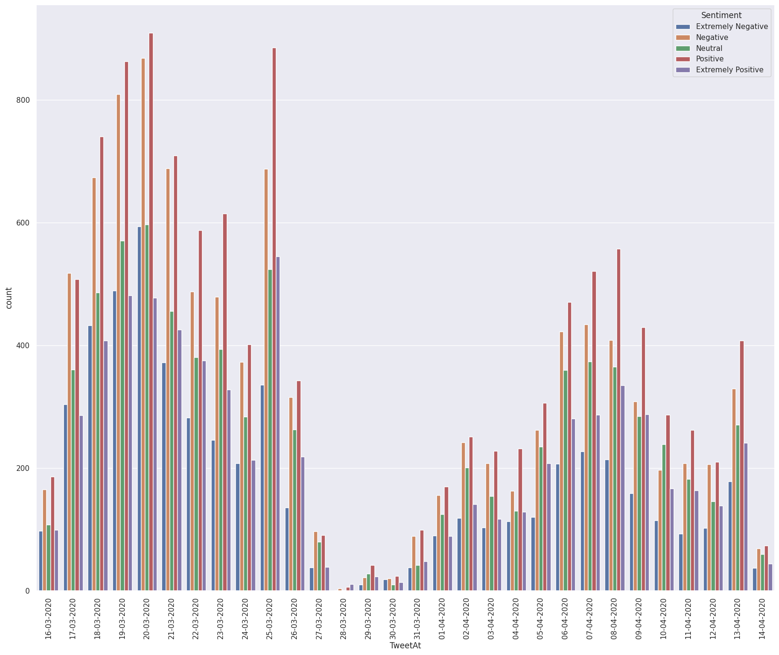
Day wise Tweet Count With Sentiment
The count plot highlights a significant peak in sentiment analysis on 20-03-2020, indicating that the majority of tweets posted on that date conveyed positive emotions or opinions. It is worth noting that without specific numerical values or further context, it is not possible to provide precise sentiment scores or analyze the relative differences between the dates in a quantitative manner.

Slide 9
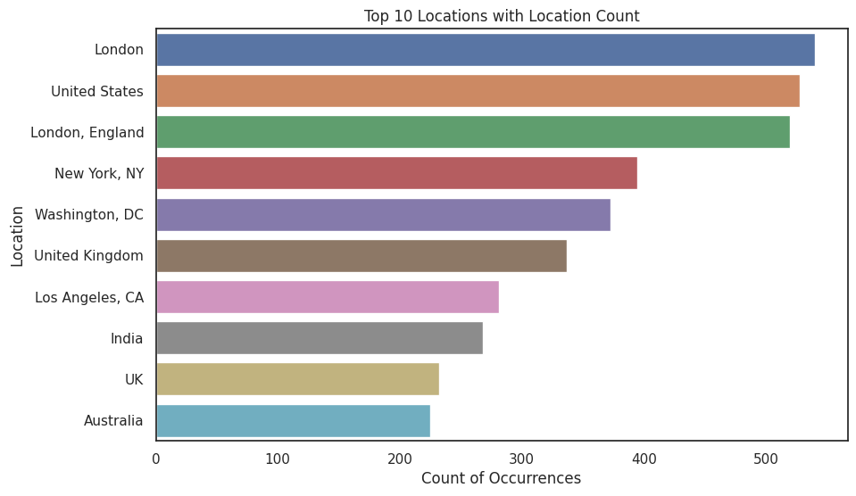
Top 10 Location count
Based on the bar plot illustrating the number of tweets from the top 15 locations, it is evident that the location "London" has the highest count of tweets, with a total of 540 tweets. This indicates that London stands out as the location with the most significant tweet activity among the listed locations.
On the other hand, the location "Australia" exhibits the lowest count of tweets, with a total of 225 tweets. This suggests that Australia has comparatively lower tweet engagement when compared to the other locations in the dataset.

Slide 10
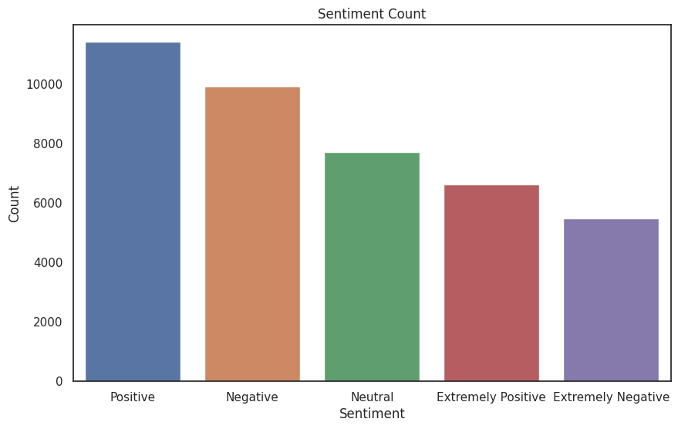
Sentiment Countplot
By this Bar graph the highest sentiment frol the users is Positive
Second highest sentiment is Negative
Least sentiment is Extremely Negative

Slide 11
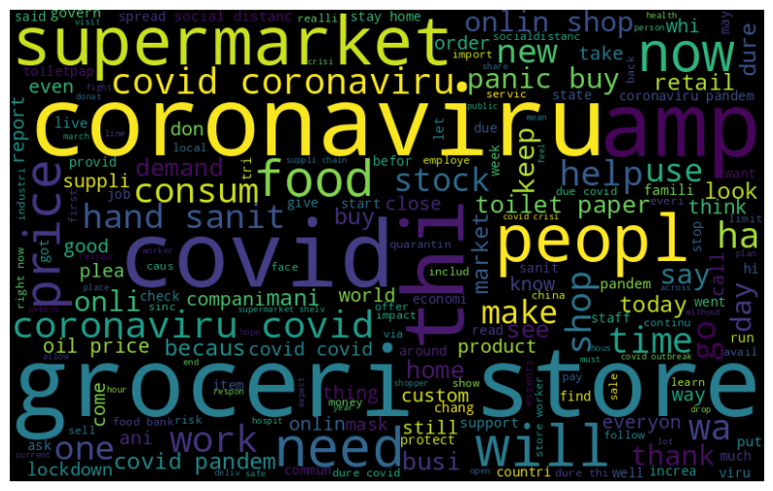
Word Cloud of Tweet Column
This Word cloud Plot shows that Which word frequently repeated.
Here Corona virus word repeated more times in this column
grocer store word also repeated more times

Slide 12
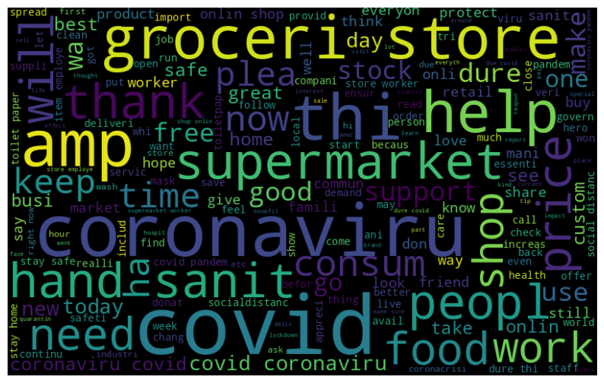
Word Cloud plot for Extremely Positive Sentiment
This Word Cloud plot represents which word repeated more times in this column
In this column Covid repeated More times.
After Covid word, Coronavirus repeated more times

Slide 13
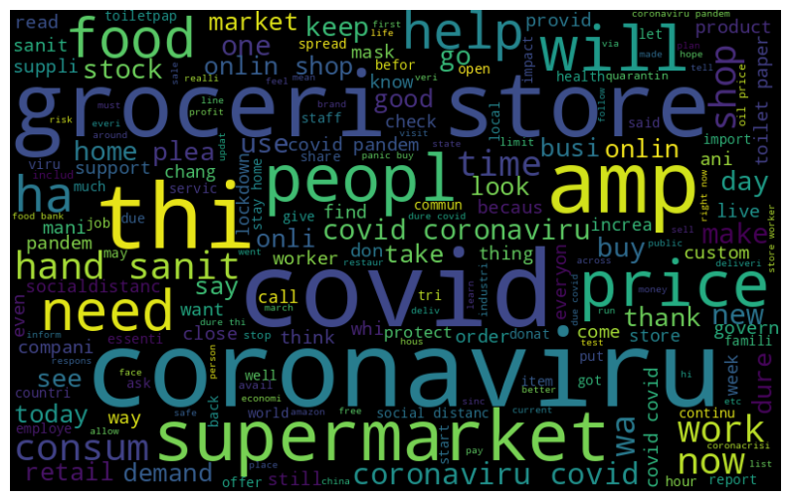
Word Cloud Plot on Positive column
This Word cloud plot represents the which word repeated more times in this column.
In this column Coronavirus word mostly repeated, and COVID word also repeated more times

Slide 14
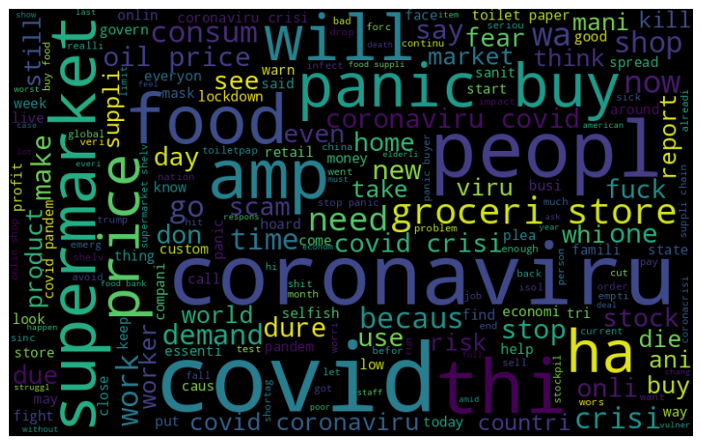
Word Cloud Plot on Extremely Negative Column
This word plot shows in this Extremely Negative column COVID word repeated more times.
Coronavirus word also repeated more times in this column

Slide 15
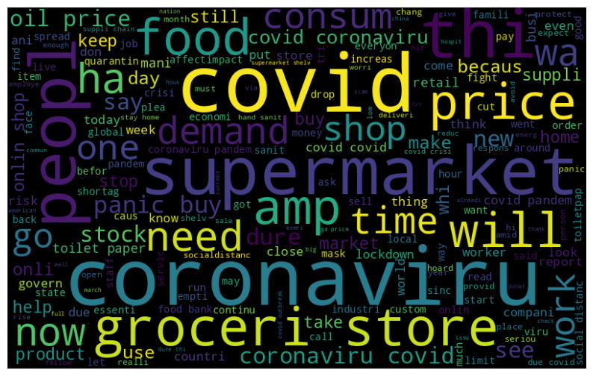
Word Cloud Plot on Negative Column
This Word cloud plot represents int this column Coronavirus repeated more times.
COVID and SuperMarket words repeated more times after Coronavirus column

Slide 16
Players in this Tweet Sentiment Analysis Game of Multi Class
Naive Bayes Classifier
Stochastic Gradient Descent-SGD
Random Forest Classifier
Support vector machine
Logistic Regression
CATBOOST MODEL

Slide 17
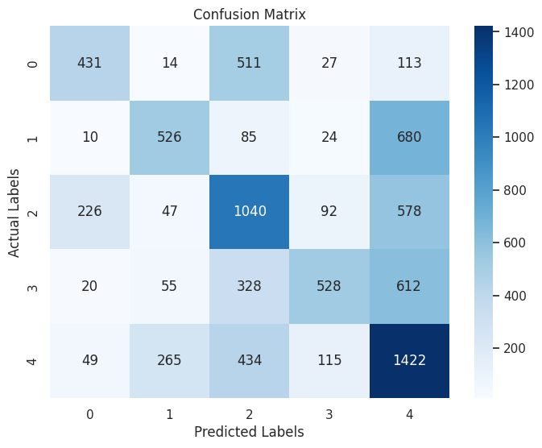
Naive Bayes Classifier
Training accuracy Score : 0.6931511009870919
Validation accuracy Score : 0.47947035957240036
precision recall f1-score support
Extremely Negative 0.39 0.59 0.47 736
Extremely Positive 0.40 0.58 0.47 907
Negative 0.52 0.43 0.47 2398
Neutral 0.34 0.67 0.45 786
Positive 0.62 0.42 0.50 3405
accuracy 0.48 8232
macro avg 0.46 0.54 0.47 8232
weighted avg 0.52 0.48 0.48 8232

Slide 18
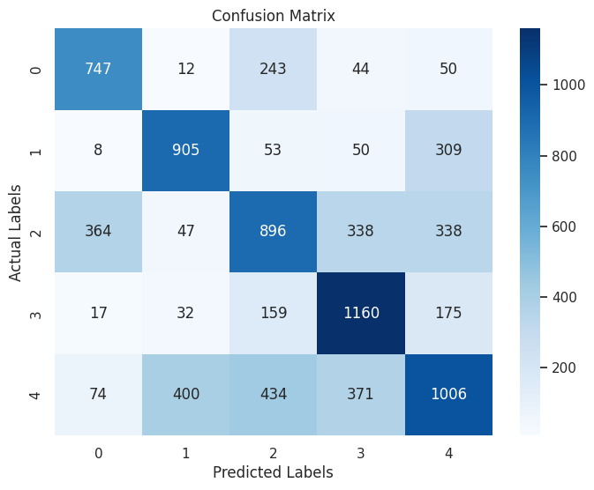
Stochastic Gradient Descent-SGD
Training accuracy Score : 0.8288838268792711
Validation accuracy Score : 0.5726433430515063
precision recall f1-score support
Extremely Negative 0.68 0.62 0.65 1210
Extremely Positive 0.68 0.65 0.67 1396
Negative 0.45 0.50 0.48 1785
Neutral 0.75 0.59 0.66 1963
Positive 0.44 0.54 0.48 1878

Slide 19
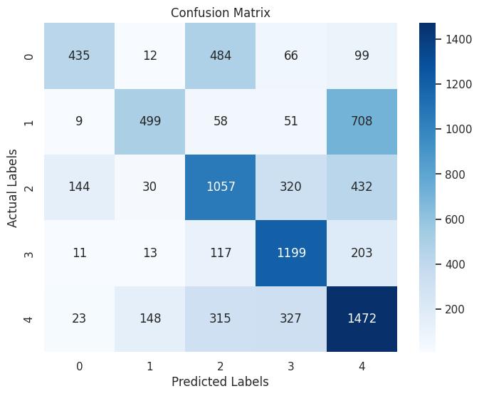
Random Forest Classifier
Training accuracy Score : 0.9958997722095672
Validation accuracy Score : 0.5663265306122449
precision recall f1-score support
Extremely Negative 0.40 0.70 0.51 622
Extremely Positive 0.38 0.71 0.49 702
Negative 0.53 0.52 0.53 2031
Neutral 0.78 0.61 0.68 1963
Positive 0.64 0.51 0.57 2914
accuracy 0.57 8232
macro avg 0.55 0.61 0.56 8232
weighted avg 0.61 0.57 0.57 8232

Slide 20
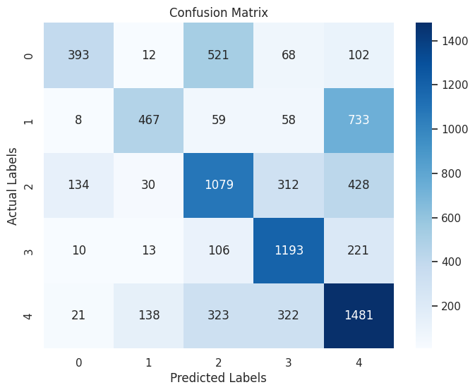
Support vector machine
Training accuracy Score : 0.9958997722095672
Validation accuracy Score : 0.560374149659864
precision recall f1-score support
Extremely Negative 0.36 0.69 0.47 566
Extremely Positive 0.35 0.71 0.47 660
Negative 0.54 0.52 0.53 2088
Neutral 0.77 0.61 0.68 1953
Positive 0.65 0.50 0.56 2965
accuracy 0.56 8232
macro avg 0.54 0.61 0.54 8232
weighted avg 0.61 0.56 0.57 8232

Slide 21
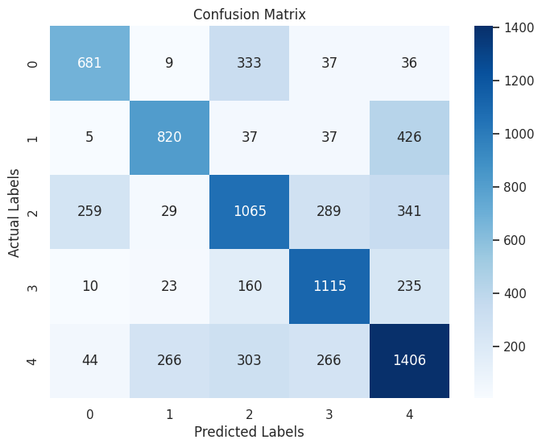
Logistic Regression
Training accuracy Score : 0.8861047835990888
Validation accuracy Score : 0.6179543245869776
precision recall f1-score support
Extremely Negative 0.62 0.68 0.65 999
Extremely Positive 0.62 0.71 0.66 1147
Negative 0.54 0.56 0.55 1898
Neutral 0.72 0.64 0.68 1744
Positive 0.62 0.58 0.59 2444
accuracy 0.62 8232
macro avg 0.62 0.63 0.63 8232
weighted avg 0.62 0.62 0.62 8232

Slide 22
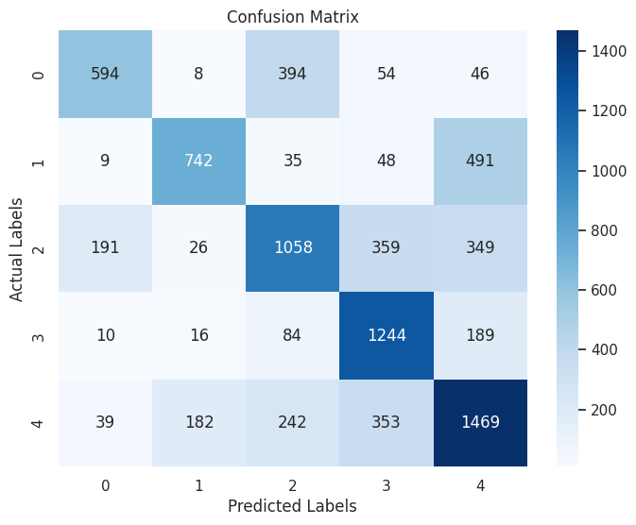
CATBOOST MODEL
Training accuracy Score : 0.6703720577069097
Validation accuracy Score : 0.6203838678328474
precision recall f1-score support
Extremely Negative 0.54 0.70 0.61 843
Extremely Positive 0.56 0.76 0.65 974
Negative 0.53 0.58 0.56 1813
Neutral 0.81 0.60 0.69 2058
Positive 0.64 0.58 0.61 2544
accuracy 0.62 8232
macro avg 0.62 0.65 0.62 8232
weighted avg 0.64 0.62 0.62 8232

Slide 23
Who is the WINNER
Naive Bayes
Training accuracy Score : 0.6931511009870919
Validation accuracy Score : 0.47947035957240036
Logistic Regression
Stochastic Gradient Descent-SGD
Training accuracy Score : 0.8861047835990888
Validation accuracy Score : 0.6179543245869776
Training accuracy Score : 0.8288838268792711
Validation accuracy Score : 0.5726433430515063
Random Forest Classifier
CAT BOOST
Training accuracy Score : 0.9958997722095672
Validation accuracy Score : 0.5663265306122449
Training accuracy Score : 0.6703720577069097
Validation accuracy Score : 0.6203838678328474
Support Vector Machine
Training accuracy Score : 0.9958997722095672
Validation accuracy Score : 0.560374149659864

Slide 24
Players in this Tweet Sentiment Analysis Game of Binary Class
Naive Bayes Classifier
Stochastic Gradient Descent-SGD
Random Forest Classifier
Support vector machine
Logistic Regression
CATBOOST MODEL

Slide 25
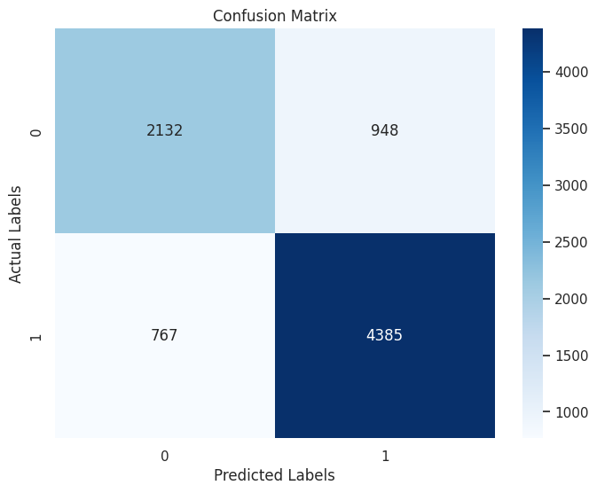
NAIVE BAYES CLASSIFIER
Training accuracy Score : 0.8585573272589218
Validation accuracy Score : 0.7916666666666666
precision recall f1-score support
0 0.69 0.74 0.71 2899
1 0.85 0.82 0.84 5333
accuracy 0.79 8232
macro avg 0.77 0.78 0.77 8232
weighted avg 0.80 0.79 0.79 8232

Slide 26
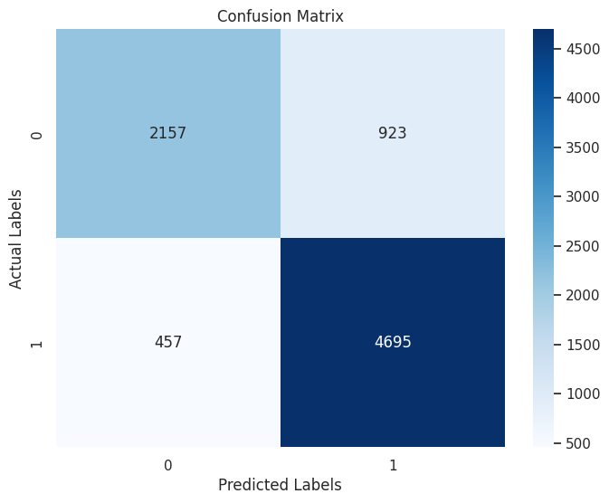
RANDOM FOREST CLASSIFIER
Training accuracy Score : 0.9985725132877753
Validation accuracy Score : 0.8323615160349854
precision recall f1-score support
0 0.70 0.83 0.76 2614
1 0.91 0.84 0.87 5618
accuracy 0.83 8232
macro avg 0.81 0.83 0.81 8232
weighted avg 0.84 0.83 0.84 8232

Slide 27
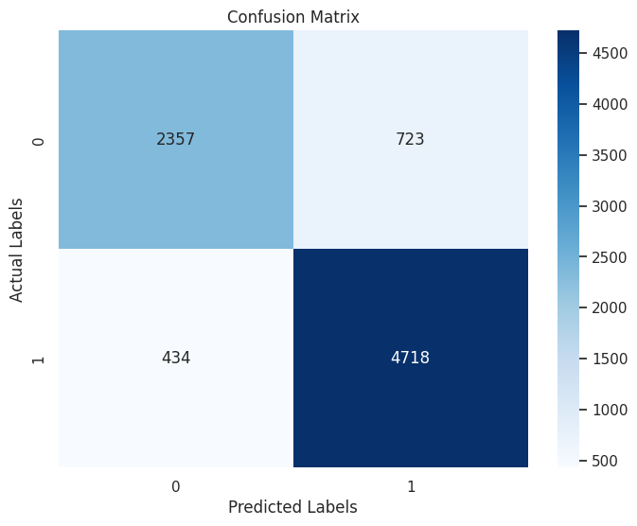
LOGISTIC REGRESSION
Training accuracy Score : 0.937798025816249
Validation accuracy Score : 0.8594509232264335
precision recall f1-score support
0 0.77 0.84 0.80 2791
1 0.92 0.87 0.89 5441
accuracy 0.86 8232
macro avg 0.84 0.86 0.85 8232
weighted avg 0.86 0.86 0.86 8232

Slide 28

CATBOOST ALGORITHM
Training accuracy Score : 0.8838572513287776
Validation accuracy Score : 0.8507045675413022
precision recall f1-score support
0 0.72 0.86 0.78 2575
1 0.93 0.85 0.89 5657
accuracy 0.85 8232
macro avg 0.82 0.85 0.83 8232
weighted avg 0.86 0.85 0.85 8232

Slide 29

SUPPORT VECTOR MACHINE
Training accuracy Score : 0.9569020501138952
Validation accuracy Score : 0.8456025267249757
precision recall f1-score support
0 0.69 0.87 0.77 2467
1 0.94 0.84 0.88 5765
accuracy 0.85 8232
macro avg 0.82 0.85 0.83 8232
weighted avg 0.86 0.85 0.85 8232

Slide 30

Stochastic Gradient Descent-SGD
Training accuracy Score : 0.9350949126803341
Validation accuracy Score : 0.8624878522837707
precision recall f1-score support
0 0.78 0.84 0.81 2882
1 0.91 0.88 0.89 5350
accuracy 0.86 8232
macro avg 0.85 0.86 0.85 8232
weighted avg 0.87 0.86 0.86 8232

Slide 31
Who is the WINNER
Naive Bayes
Training accuracy Score : 0.8585573272589218
Validation accuracy Score : 0.7916666666666666
Logistic Regression
Stochastic Gradient Descent-SGD
Training accuracy Score : 0.937798025816249
Validation accuracy Score : 0.8594509232264335
Training accuracy Score : 0.9350949126803341
Validation accuracy Score : 0.8624878522837707
Random Forest Classifier
CAT BOOST
Training accuracy Score : 0.9985725132877753
Validation accuracy Score : 0.8323615160349854
Training accuracy Score : 0.8838572513287776
Validation accuracy Score : 0.8507045675413022
Support Vector Machine
Training accuracy Score : 0.9569020501138952
Validation accuracy Score : 0.8456025267249757

Slide 32
Conclusion
From London location we got highest tweets.
In multi class and Binary Class CATBOST ALGORITHM is a winner
By using this N.L.P we can detect human emotions by their text

Slide 33


Slide 34


